Slide 1
Raspberry Pi 2/3 GPIO
- LED, Button
jyheo@hansung.ac.kr

Slide 2
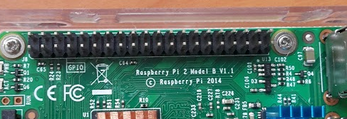
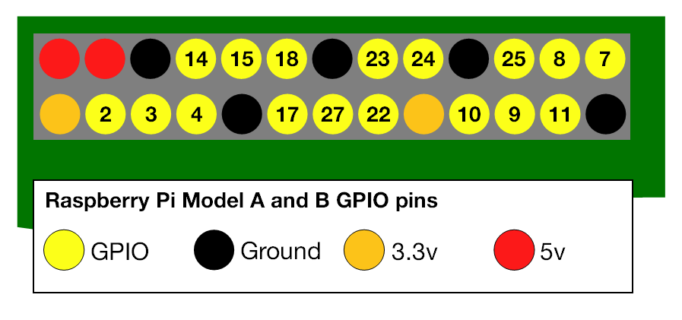
Raspberry Pi 2/3 GPIO
GPIO: General Purpose Input/Output

Slide 3
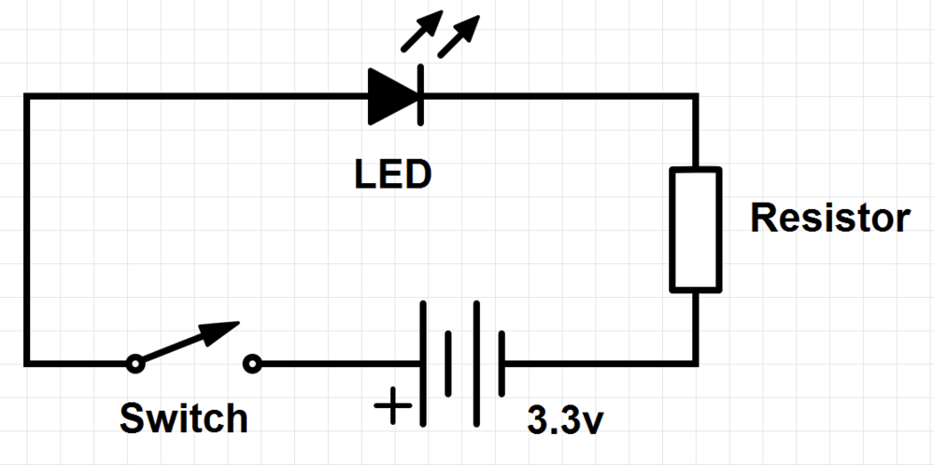
RPi2 GPIO - LED
Source: https://www.raspberrypi.org/documentation/usage/gpio/

Slide 4
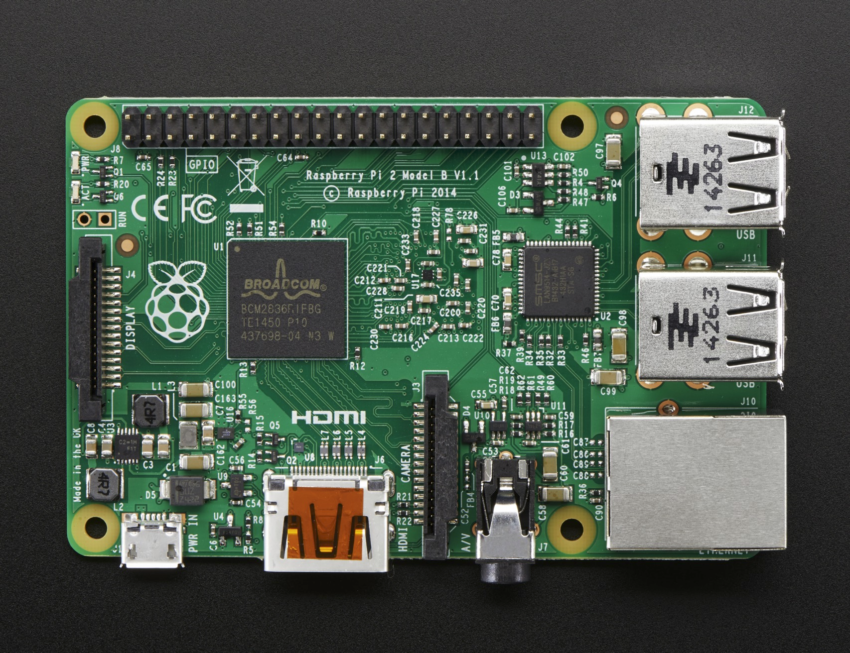
RPi2 GPIO - LED
Source: https://www.raspberrypi.org/documentation/usage/gpio/

Slide 5
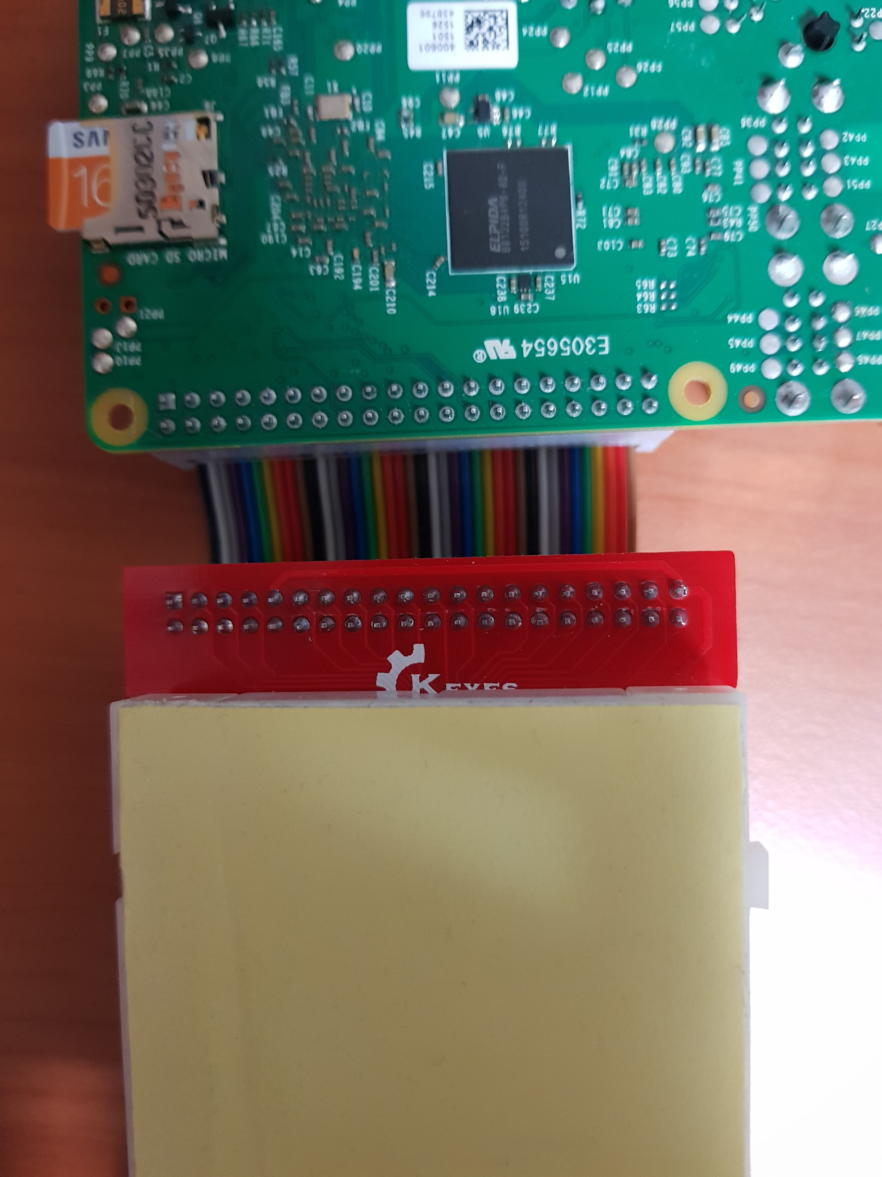
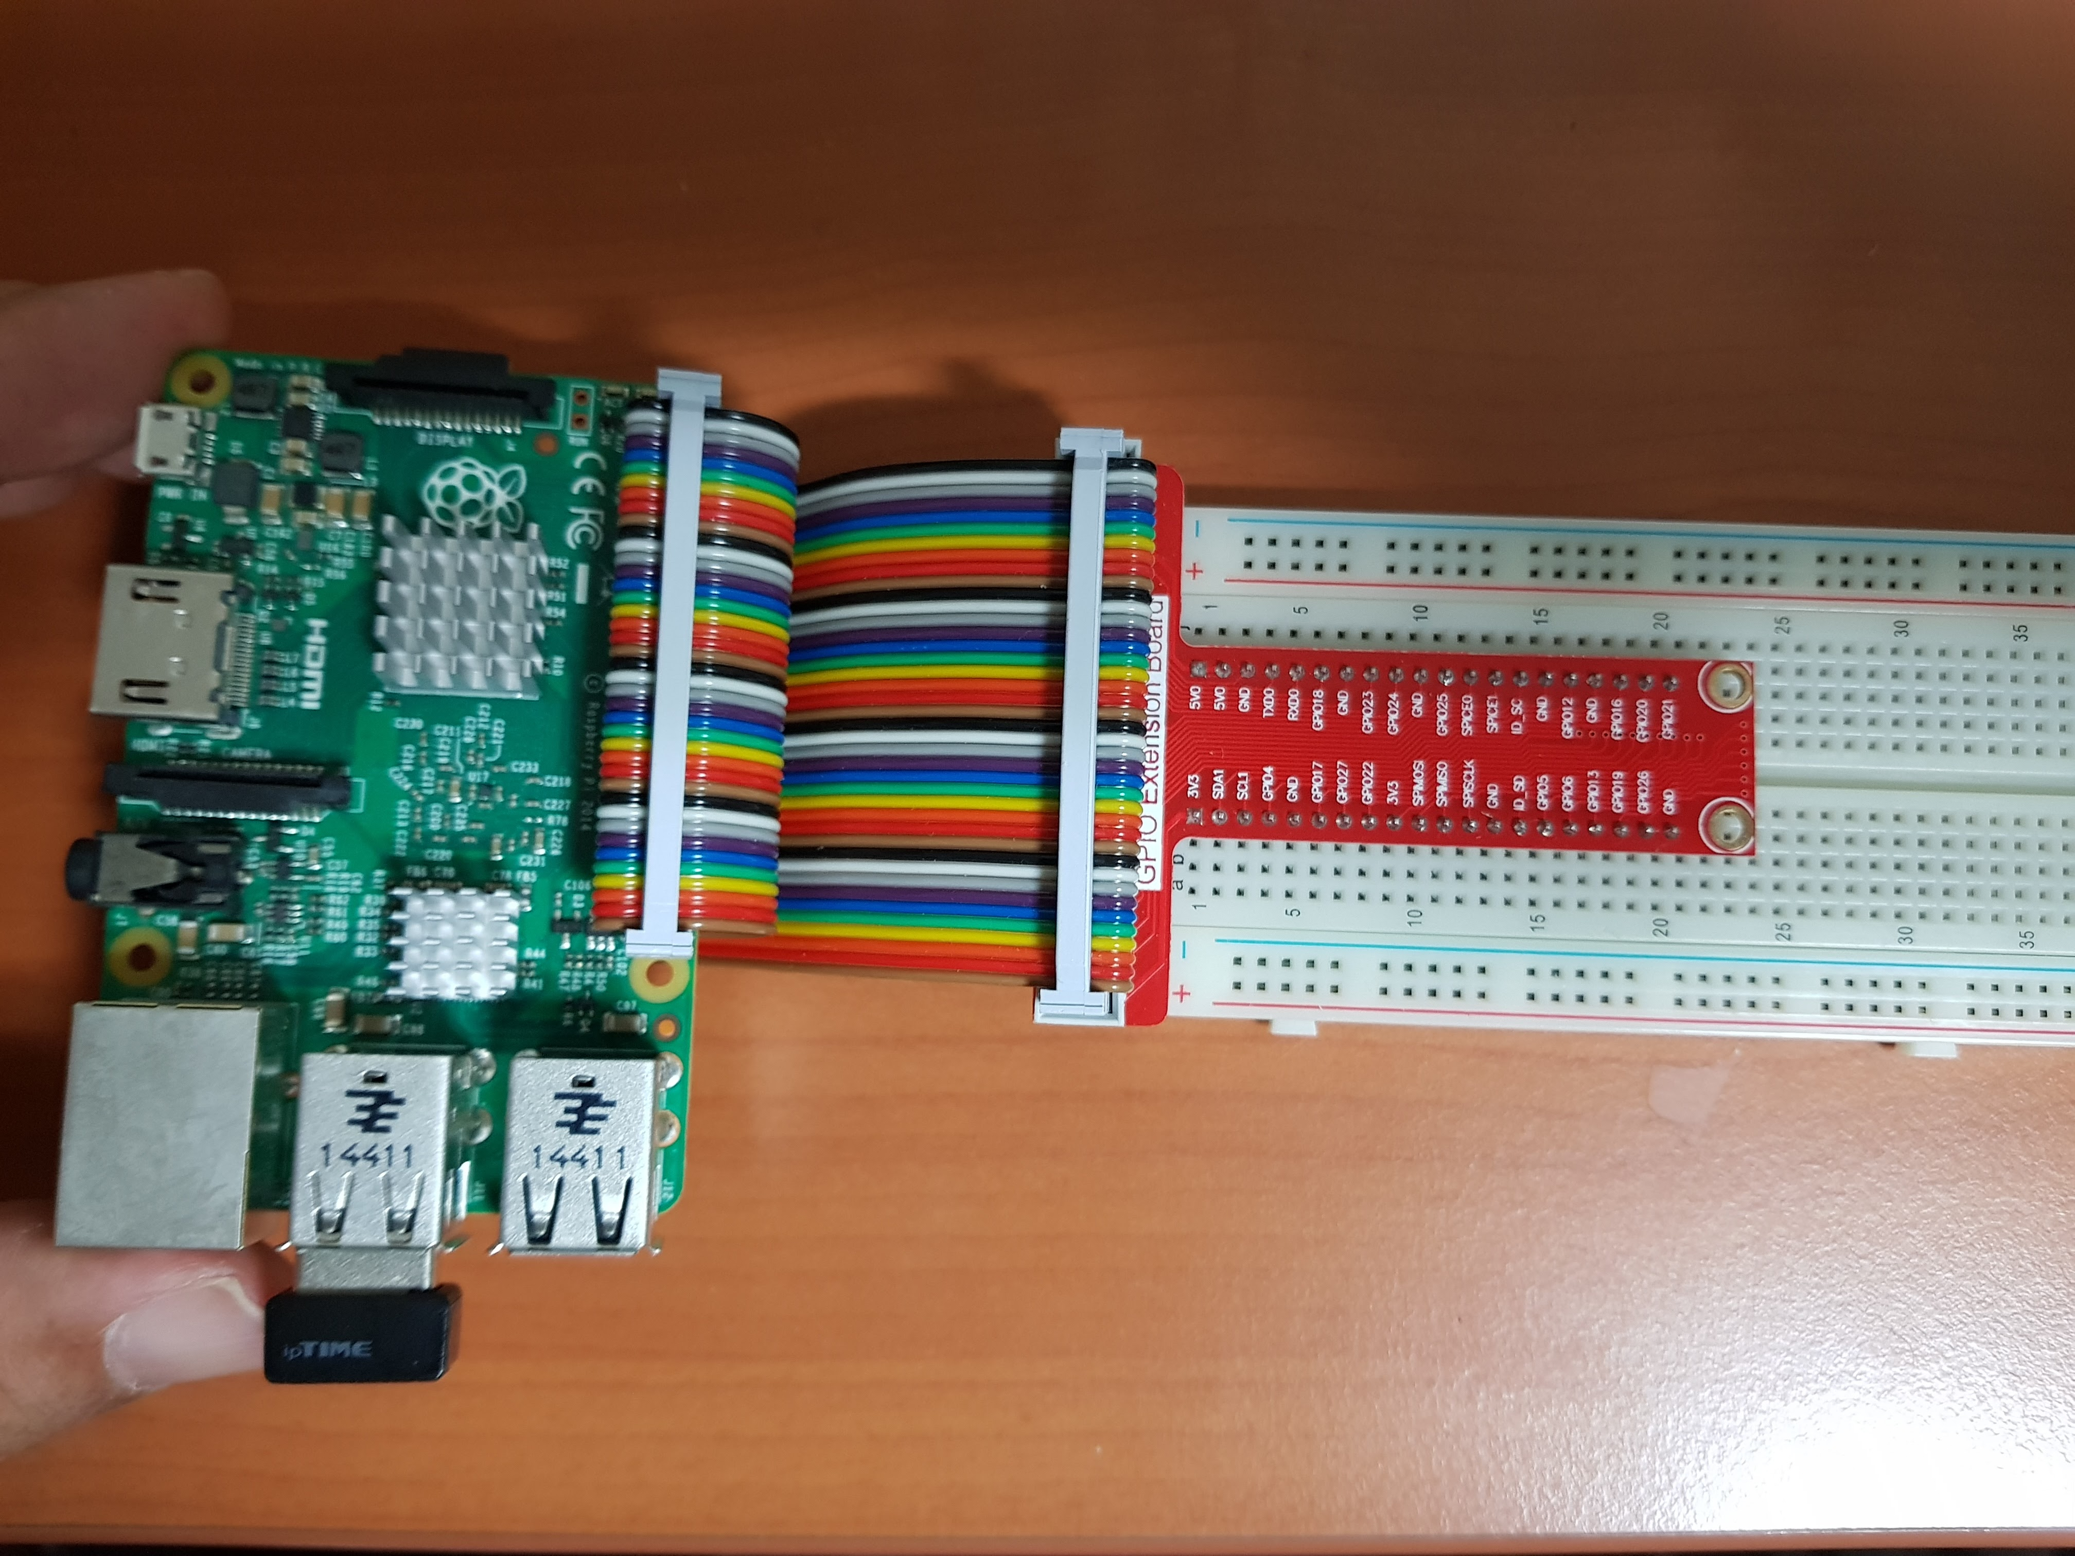
RPi2 + Breadboard

Slide 6
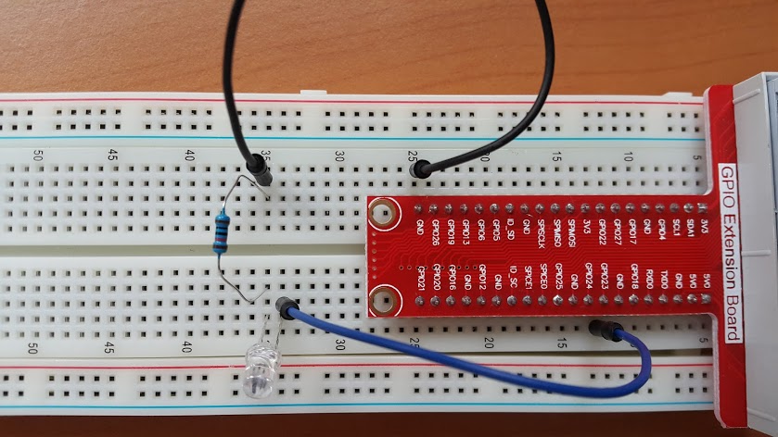
RPi2 GPIO - LED
Be Carefull while Wiring!
GND
GPIO24
LED: longer leg must be connected to + (GPIO24).

Slide 7
RPi2 GPIO - LED
import RPi.GPIO as GPIO
import time
GPIO.setmode(GPIO.BCM)
GPIO.setwarnings(False)
led=24 # GPIO channel number
GPIO.setup(led, GPIO.OUT)
GPIO.output(led, 1)
time.sleep(2)
GPIO.output(led, 0)
$ nano gpio-led.py
$ python3 gpio-led.py
https://github.com/jyheo/rpi2/blob/master/gpio-led.py

Slide 8
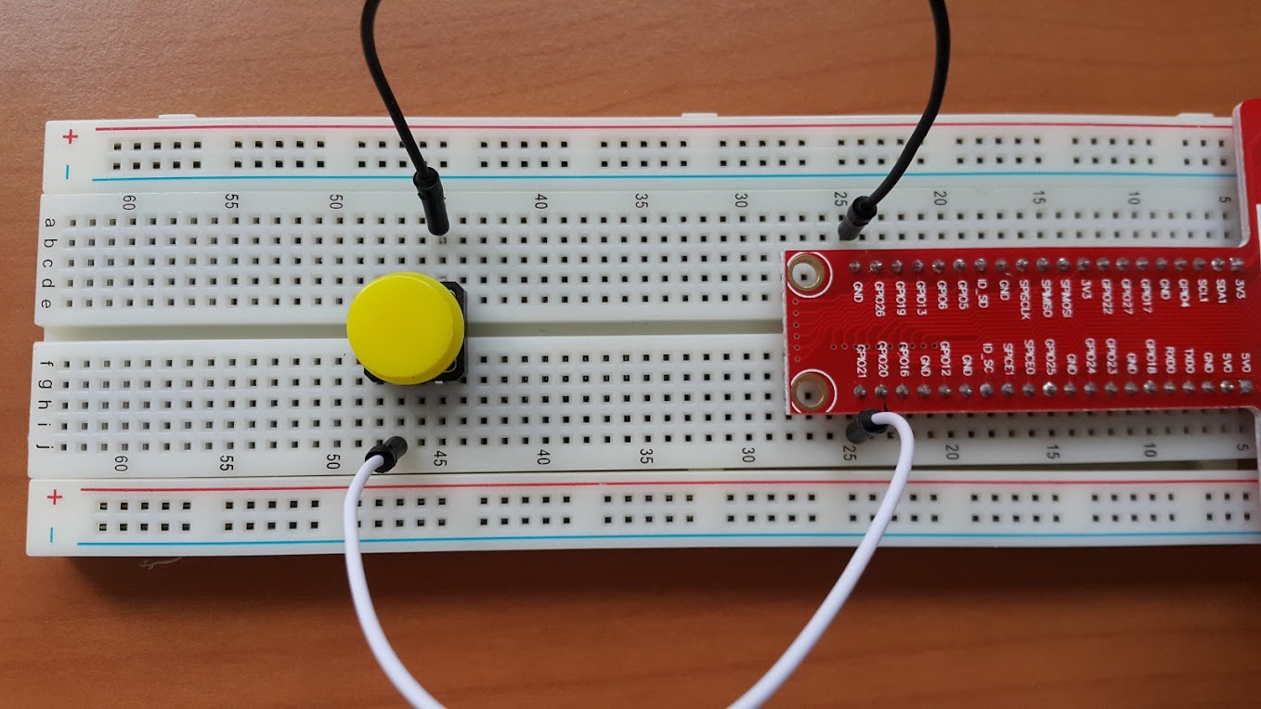
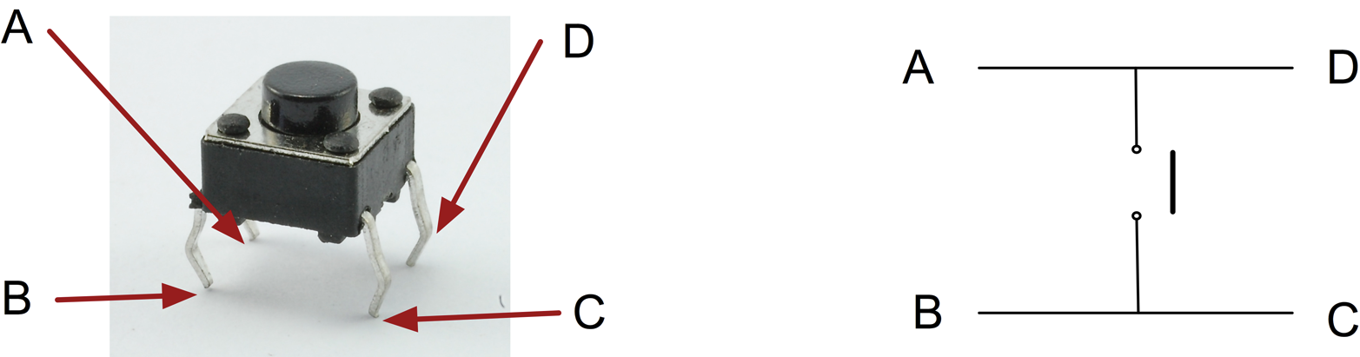
RPi2 GPIO - Button
Be Carefull while Wiring!
GPIO21
Source: http://razzpisampler.oreilly.com/ch07.html

Slide 9
RPi2 GPIO - Button
import RPi.GPIO as GPIO
import time
GPIO.setmode(GPIO.BCM)
GPIO.setwarnings(False)
button = 21
GPIO.setup(button, GPIO.IN, GPIO.PUD_UP)
while True:
if GPIO.input(button) == False:
print("Button pressed.")
break
$ nano gpio_button.py
$ python3 gpio_button.py Button pressed
https://github.com/jyheo/rpi2/blob/master/gpio_button.py

Slide 10
RPi2 GPIO - Button, Callback example
import RPi.GPIO as GPIO
import time
def button_pressed(channel):
print("Button pressed.")
GPIO.setmode(GPIO.BCM)
GPIO.setwarnings(False)
button = 21
GPIO.setup(button, GPIO.IN, GPIO.PUD_UP)
GPIO.add_event_detect(button, GPIO.RISING, bouncetime=200) # rising edge detection
GPIO.add_event_callback(button, button_pressed) # callback
while True:
continue
https://github.com/jyheo/rpi2/blob/master/gpio_button2.py

Slide 11
Reference
GPIO with Python
https://www.raspberrypi.org/documentation/usage/gpio/
http://sourceforge.net/p/raspberry-gpio-python/wiki/BasicUsage/
GPIO with C
http://blog.naver.com/elepartsblog/220284169123
http://blog.naver.com/elepartsblog/220285369508
Advanced
http://wiringpi.com/
http://raspberrypi.znix.com/hipidocs/topic_gpiodev.htm (GPIO driver)

Slide 12
Exercise
2 buttons, 1 LED
When one button is pressed, turn LED on
When the other button is pressed, turn LED off

